Slide 1

19CS2211 - Software Engineering
Software Testing Strategies
Session – 19

Slide 2

INTRODUCTION
Software Testing Strategies
describes the steps to be conducted
effort, time, and resources will be required
test planning, test case design, test execution, and resultant data collection and evaluation
flexible enough to promote a customized testing approach.
reasonable planning and management tracking as the project progresses
Testing - process - intent of finding errors prior to delivery to the end user.

Slide 3
What Testing Shows
errors
requirements conformance
performance
an indication
of quality

Slide 4
A Strategic Approach To Software Testing
To perform effective testing - technical reviews
Testing begins at the component level
Different testing techniques
Testing is conducted – by independent group
Testing and debugging are different activities

Slide 5
Verification and Validation
Verification
to ensure that software correctly implements a specific function.
Validation
to ensure task is traceable to customer requirements.
Verification: "Are we building the product right?"
Validation: "Are we building the right product?"

Slide 6
Organizing for Software Testing
Developer:
testing the individual units (components)
ensuring that function behavior for which it was designed.
Independent Test Group (ITG):
remove the inherent problems
removes the conflict of interest
ITG personnel are paid to find errors

Slide 7
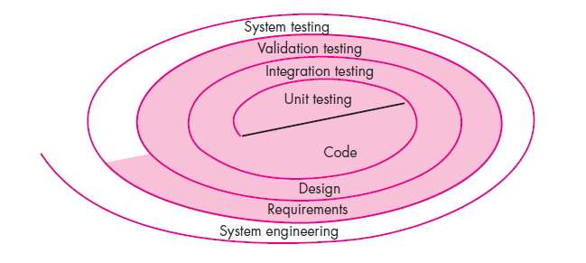
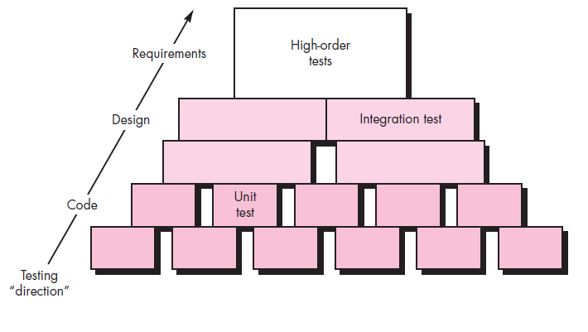
Software Testing Strategy—The Big Picture

Slide 8
Testing Strategy
Begin with “testing-in-the-small” and move toward “testing-in-the-large”
For conventional software
The module (component) is first initial focus
Integration of modules follows
For Object Oriented software
our focus when “testing in the small” changes from an individual module (the conventional view) to an OO class that encompasses attributes and operations and implies communication and collaboration

Slide 9
Strategic Issues
Specify product requirements in a quantifiable manner long before testing commences.
State testing objectives explicitly.
Understand the users of the software and develop a profile for each user category.
Develop a testing plan that emphasizes “rapid cycle testing.”
Build “robust” software that is designed to test itself.
Use effective technical reviews as a filter prior to testing.
Conduct technical reviews to assess the test strategy and test cases themselves.
Develop a continuous improvement approach for the testing process.

Slide 10
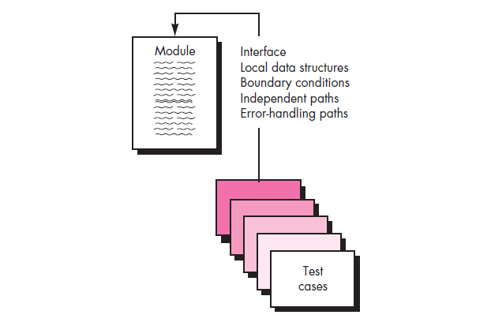
Test Strategies for Conventional Software
A testing strategy incremental view of testing
Unit Testing
Integration Testing
Unit Testing:
Verification on the smallest unit of software

Slide 11
Unit Testing
Verification on the smallest unit of software
Unit-test considerations:
ensure that information properly flows into and out of the program unit under test.
All independent paths through the control structure are exercised to ensure that all statements in a module have been executed at least once.
Boundary conditions are tested to ensure that the module operates properly at boundaries established to limit or restrict processing.
All error-handling paths are tested.

Slide 12
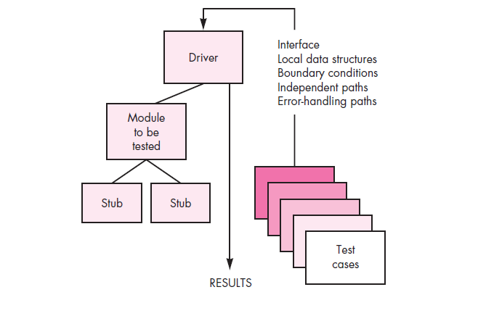
Unit-test Procedures
Unit testing is normally considered as an adjunct (i.e., extra) to the coding step.
The design of unit tests can occur before coding begins or after source code has been generated.
A review of design information provides guidance for uncovering.

Slide 13
Integration Testing
It is a systematic technique for constructing the software architecture
To uncover errors associated with interfacing.
The objective is to take unit-tested components and build a program structure that has been dictated by design.
Top-down integration:
Top-down integration testing is an incremental approach
Modules are integrated by moving downward through the control hierarchy, beginning with the main control module(main program).
Modules subordinate (and ultimately subordinate) to the main control module are incorporated into the structure in either a depth-first or breadth-first manner

Slide 14
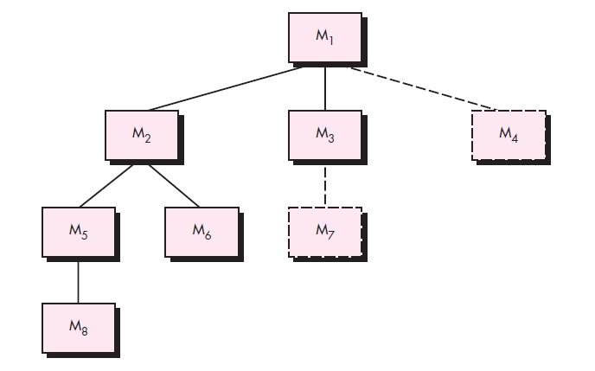
Depth-first integration integrates all components on a major control path of the program structure.

Slide 15
The integration process is performed in a series of five steps:
1. The main control module is used as a test driver and stubs are substituted for all components directly subordinate to the main control module.
2. Depending on the integration approach selected (i.e., depth or breadth first), subordinate stubs are replaced one at a time with actual components.
3. Tests are conducted as each component is integrated.
4. On completion of each set of tests, another stub is replaced with the real component.
5. Regression testing (discussed later in this section) may be conducted to ensure that new errors have not been introduced.
The process continues from step 2 until the entire program structure is built.

Slide 16
Bottom-up integration:
begins construction and testing with atomic modules (i.e., components at the lowest levels in the program structure). 1. Low-level components are combined into clusters (sometimes called builds) that perform a specific software subfunction. 2. A driver (a control program for testing) is written to coordinate test case input and output. 3. The cluster is tested. 4. Drivers are removed and clusters are combined moving upward in the program structure.

Slide 17
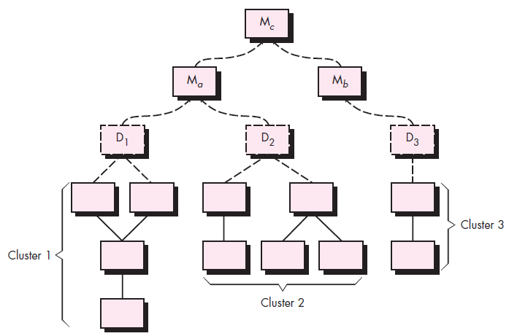

Slide 18
Regression Testing
Each time a new module is added as part of integration testing, the software changes.
New data flow paths are established, new I/O may occur, and new control logic is invoked.
These changes may cause problems with functions that previously worked flawlessly.
In the context of an integration test strategy, regression testing is the re-execution of some subset of tests that have already been conducted to ensure that changes have not propagated unintended side effects.

Slide 19
Smoke Testing
Smoke testing is an integration testing approach that is commonly used when product software is developed.
Designed for time-critical projects, allowing the software team to assess the project on a frequent basis.

Slide 20
The smoke-testing approach encompasses the following activities:
Software components -> code -> data files, libraries, reusable modules, and engineered components
Series of tests is designed - to expose errors.
The build (product) is integrated with other builds, and the entire product (in its current form) is smoke tested daily.
The integration approach may be top down or bottom up.

Slide 21
Benefits of Smoke Test:
Integration risk is minimized.
The quality of the end product is improved.
Error diagnosis and correction are simplified.
Progress is easier to assess.

Slide 22
Revision Questions
Define Software Testing.
2. Explain A Strategic Approach To Software Testing in detail
Sketch how testing strategy is represented in spiral model and explain.
Explain in detail about Testing Strategy.
List out the Strategic Issues of Software testing.
Explain Smoke Test in detail.

Slide 23
Thank You

Slide 24
19CS2211 - Software Engineering
Software Testing
Session – 20

Slide 25
Black-box Testing
Also called behavioral testing
Focuses - functional requirements of software.
Enable sets of input conditions - fully exercise all functional requirements for a program.
Black-box testing is not an alternative to white-box techniques.
To uncover a different class of errors.

Slide 26
Tests are designed to answer the following questions:
How is functional validity tested?
How are system behavior and performance tested?
What classes of input will make good test cases?
Is the system particularly sensitive to certain input values?
How are the boundaries of a data class isolated?
What data rates and data volume can the system tolerate?
What effect will specific combinations of data have on system operation?

Slide 27
By applying black-box techniques, you derive a set of test cases that satisfy the following criteria:
test cases that reduce, by a count that is greater than one, the number of additional test cases that must be designed to achieve reasonable testing, and
test cases that tell you something about the presence or absence of classes of errors, rather than an error associated only with the specific test at hand.

Slide 28
Graph-Based Testing Methods
Understand the objects in software
Connect these objects using relationships.
Define a series of tests - all objects have the expected relationship to one another.
A number of behavioral testing methods that can make use of graphs:
Transaction flow modeling.
Finite state modeling.
Data flow modeling.
Timing modeling.

Slide 29
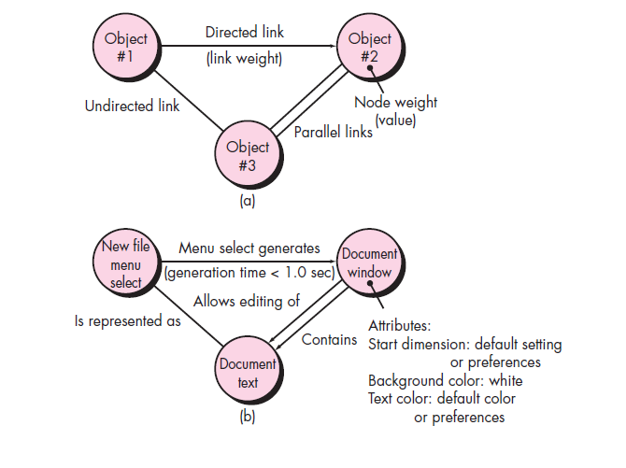
(a) Graph notation (b) simple example

Slide 30
Equivalence Partitioning
It is a black-box testing method.
Divides the input domain into classes of data
from these data - test cases can be derived.
Test-case design - based on an evaluation of equivalence classes for an input condition.

Slide 31
Equivalence classes may be defined according to the following guidelines:
1. If an input condition specifies a range, one valid and two invalid equivalence classes are defined.
2. If an input condition requires a specific value, one valid and two invalid equivalence classes are defined.
3. If an input condition specifies a member of a set, one valid and one invalid equivalence class are defined.
4. If an input condition is Boolean, one valid and one invalid class are defined.

Slide 32
Boundary Value Analysis (BVA)
More errors occurs at the boundaries in input
Lesser errors in “center” in input
For this reason that boundary value analysis (BVA) has been developed as a testing technique.
BVA leads to a selection of test cases that exercise bounding values.

Slide 33
Guidelines for BVA are similar in many respects to those provided for equivalence partitioning:
If an input condition specifies a range bounded by values a and b, test cases should be designed with values a and b and just above and just below a and b.
If an input condition specifies a number of values, test cases should be developed that exercise the minimum and maximum numbers. Values just above and below minimum and maximum are also tested.

Slide 34
Apply guidelines 1 and 2 to output conditions. Test cases should be designed to create an output report that produces the maximum (and minimum) allowable number of table entries.
If internal program data structures have prescribed boundaries (e.g., a table has a defined limit of 100 entries), be certain to design a test case to exercise the data structure at its boundary.

Slide 35
Orthogonal Array Testing
Applied to problems in which the input domain is relatively small but too large to accommodate exhaustive testing.
Useful in finding region faults - faulty logic within a software component.

Slide 36
Black-box Testing
To find errors in the following categories:
incorrect or missing functions
interface errors
errors in data structures or external database access
behavior or performance errors
initialization and termination errors

Slide 37
White-box Testing
Called glass-box testing
Used in control structure
guarantee that all independent paths within a module have been exercised at least once
exercise all logical decisions on their true and false sides
execute all loops at their boundaries and within their operational bounds
exercise internal data structures to ensure their validity

Slide 38
Validation Testing
It begins at the culmination of integration testing
when individual components have been exercised, the software is completely assembled as a package, and interfacing errors have been uncovered and corrected.
At the validation or system level, the distinction between conventional software, object-oriented software, and WebApps disappears.
Testing focuses on user-visible actions and user-recognizable output from the system.

Slide 39
Validation Criteria:
After each validation test case has been conducted, one of two possible conditions exists:
The function or performance characteristic conforms to specification and is accepted or
a deviation from specification is uncovered and a deficiency list is created.
Note:
Deviations or errors discovered at this stage in a project can rarely be corrected prior to scheduled delivery.

Slide 40
Configuration Review:
To ensure that all elements of the software configuration have been properly developed, are cataloged, and have the necessary detail to bolster the support activities.

Slide 41
Alpha and Beta Testing
The alpha test:
Conducted at the developer’s site
Developer should present
Used in a natural setting with the developer “looking over the shoulder” of the users and recording errors and usage problems.
The beta test:
Conducted at one or more end-user sites.
Developer generally is not present.
Therefore, the beta test is a “live” application of the software in an environment that cannot be controlled by the developer.

Slide 42
A variation on beta testing, called customer acceptance testing:
Performed when software is delivered to a customer under contract.
The customer performs a series of specific tests in an attempt to uncover errors before accepting the software from the developer.

Slide 43
System Testing
series of different tests whose primary purpose is to fully exercise the computer-based system.
Purpose - to verify that system elements have been properly integrated and perform allocated functions.

Slide 44
Recovery Testing:
It is a system test
It forces the software to fail in a variety of ways and verifies that recovery is properly performed.
If recovery is automatic (performed by the system itself), re-initialization, check pointing mechanisms, data recovery, and restart are evaluated for correctness.
Security Testing:
Protect the system from improper penetration.

Slide 45
Stress Testing:
Executes a system – with resources in abnormal quantity, frequency, or volume.
A variation of stress testing is a technique called sensitivity testing.
Sensitivity testing - to uncover data combinations within valid input classes that may cause instability or improper processing.

Slide 46
Performance Testing:
To test the run-time performance of software within the context of an integrated system.
Performance testing occurs throughout all steps in the testing process. Performance tests are often coupled with stress testing
It require both hardware and software instrumentation.

Slide 47
Deployment Testing:
Called configuration testing
Exercises the software in each environment in which it is to operate
Examines all installation procedures and specialized installation software (e.g., “installers”) that will be used by customers
All documentation that will be used to introduce the software to end users

Slide 48
Revision Questions
Define System Testing.
2. Outline the types of System testing.
Explain behavioral testing that make use of graphs.
Distinguish White Box and Black Box Testing.
Distinguish Validation Testing and Black Box Testing.
Distinguish Performance Testing and Deployment Testing.

Slide 49
Thank You

Slide 50
Session – 21
Test Driven Development

Slide 51
Test Driven Development
TDD can be defined as a programming practice that instructs developers to write new code only if an automated test has failed. This avoids duplication of code. TDD means “Test Driven Development”. The primary goal of TDD is to make the code clearer, simple and bug-free.
Test-Driven Development starts with designing and developing tests for every small functionality of an application. In TDD approach, first, the test is developed which specifies and validates what the code will do.
In the normal Software Testing process, we first generate the code and then test. Tests might fail since tests are developed even before the development. In order to pass the test, the development team has to develop and refactors the code. Refactoring a code means changing some code without affecting its behavior.
Test-Driven development is a process of developing and running automated test before actual development of the application. Hence, TDD sometimes also called as Test First Development.

Slide 52
Contents: • What is Test Driven Development (TDD)? • How to perform TDD Test • TDD Vs. Traditional Testing • What is acceptance TDD and Developer TDD • Scaling TDD via Agile Model Driven Development (AMDD) • Test Driven Development (TDD) Vs. Agile Model Driven Development (AMDD) • Example of TDD • Benefits of TDD

Slide 53
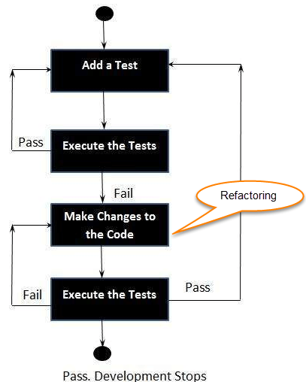
How to perform TDD Test
Following steps define how to perform TDD test,
1. Add a test.
2. Run all tests and see if
any new test fails.
3. Write some code.
4. Run tests and Refactor code.
5. Repeat.

Slide 54
TDD cycle defines
1. Write a test
2. Make it run.
3. Change the code to make it right i.e. Refactor.
4. Repeat process.
Some clarifications about TDD:
• TDD is neither about "Testing" nor about "Design".
• TDD does not mean "write some of the tests, then build a system that passes the tests.
• TDD does not mean "do lots of Testing."

Slide 55
TDD Vs. Traditional Testing
TDD approach is primarily a specification technique. It ensures that your source code is thoroughly tested at confirmatory level.
• With traditional testing, a successful test finds one or more defects. It is same as TDD. When a test fails, you have made progress because you know that you need to resolve the problem.
• TDD ensures that your system actually meets requirements defined for it. It helps to build your confidence about your system.
• In TDD more focus is on production code that verifies whether testing will work properly. In traditional testing, more focus is on test case design. Whether the test will show the proper/improper execution of the application in order to fulfill requirements.
• In TDD, you achieve 100% coverage test. Every single line of code is tested, unlike traditional testing.
• The combination of both traditional testing and TDD leads to the importance of testing the system rather than perfection of the system.
• In Agile Modeling (AM), you should "test with a purpose". You should know why you are testing something and what level its need to be tested.

Slide 56
Levels of TDD
There are two levels of TDD
Acceptance TDD (ATDD): With ATDD you write a single acceptance test. This test fulfills the requirement of the specification or satisfies the behavior of the system. After that write just enough production/functionality code to fulfill that acceptance test. Acceptance test focuses on the overall behavior of the system. ATDD also was known as Behavioral Driven Development (BDD).
Developer TDD: With Developer TDD you write single developer test i.e. unit test and then just enough production code to fulfill that test. The unit test focuses on every small functionality of the system. Developer TDD is simply called as TDD.
The main goal of ATDD and TDD is to specify detailed, executable requirements for your solution on a just in time (JIT) basis. JIT means taking only those requirements in consideration that are needed in the system. So increase efficiency.

Slide 57
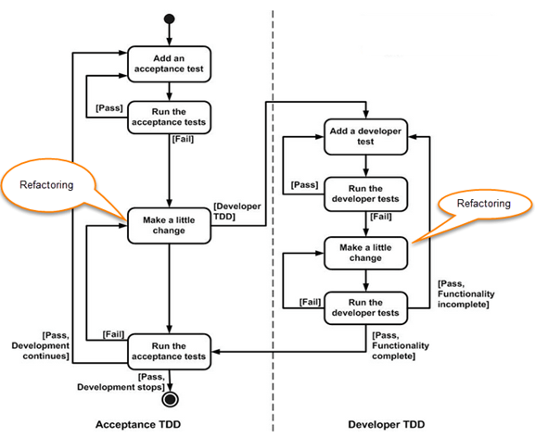
ATDD Vs DTDD

Slide 58
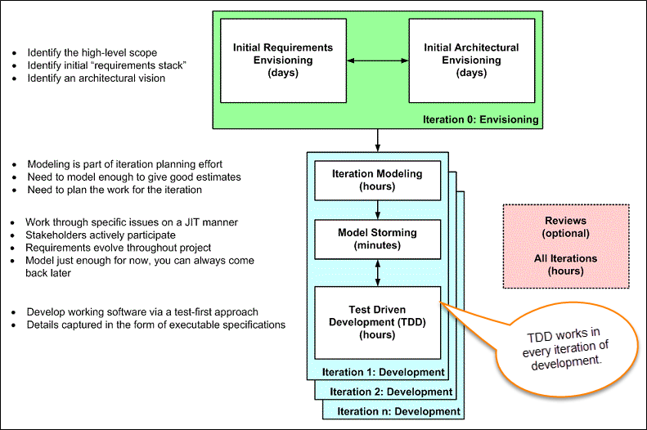
Agile Model Driven Development (AMDD)
AMDD addresses the Agile scaling issues that TDD does not.
Life Cycle of AMDD

Slide 59
Iteration 0: Envisioning
There are two main sub-activates.
1. Initial requirements envisioning.
It may take several days to identify high-level requirements and scope of the system. The main focus is to explore usage model, Initial domain model, and user interface model (UI).
2. Initial Architectural envisioning.
It also takes several days to identify architecture of the system. It allows setting technical directions for the project. The main focus is to explore technology diagrams, User Interface (UI) flow, domain models, and Change cases..

Slide 60
Iteration modeling
Here team must plan the work that will be done for each iteration.
• Agile process is used for each iteration, i.e. during each iteration, new work item will be added with priority.
• First higher prioritized work will be taken into consideration. Work items added may be reprioritized or removed from items stack any time.
• The team discusses how they are going to implement each requirement. Modeling is used for this purpose.
• Modeling analysis and design is done for each requirement which is going to implement for that iteration.

Slide 61
Model storming
This is also known as Just in time Modeling.
• Here modeling session involves a team of 2/3 members who discuss issues on paper or whiteboard.
• One team member will ask another to model with them. This modeling session will take approximately 5 to 10 minutes. Where team members gather together to share whiteboard/paper.
• They explore issues until they don't find the main cause of the problem. Just in time, if one team member identifies the issue which he/she wants to resolve then he/she will take quick help of other team members.
• Other group members then explore the issue and then everyone continues on as before. It is also called as stand-up modeling or customer QA sessions.

Slide 62
Test Driven Development (TDD)
It promotes confirmatory testing of your application code and detailed specification.
• Both acceptance test (detailed requirements) and developer tests (unit test) are inputs for TDD.
• TDD makes the code simpler and clear. It allows the developer to maintain less documentation.
Reviews
• This is optional. It includes code inspections and model reviews.
• This can be done for each iteration or for the whole project.
• This is a good option to give feedback for the project.

Slide 63
Questions
Define TDD.
Outline the steps need to performed for TDD Test.
Distinguish TDD and Traditional Testing
Explain in detail about Acceptance Testing and Developer Testing.
Distinguish Scaling TDD and AMDD.
Explain the Life cycle of AMDD.

Slide 64
19CS2211 - Software Engineering
Software Testing – Black-box Testing
Session – 21

Slide 65
Black-box Testing
It is called as behavioral testing
Focuses - functional requirements of software.
Enable sets of input conditions - fully exercise all functional requirements for a program.
Black-box testing is not an alternative to white-box techniques.
To uncover a different class of errors.

Slide 66
Tests are designed to answer the following questions:
How is functional validity tested?
How are system behavior and performance tested?
What classes of input will make good test cases?
Is the system particularly sensitive to certain input values?
How are the boundaries of a data class isolated?
What data rates and data volume can the system tolerate?
What effect will specific combinations of data have on system operation?

Slide 67
By applying black-box techniques, you derive a set of test cases that satisfy the following criteria:
test cases that reduce, by a count that is greater than one, the number of additional test cases that must be designed to achieve reasonable testing, and
test cases that tell you something about the presence or absence of classes of errors, rather than an error associated only with the specific test at hand.

Slide 68
Graph-Based Testing Methods
Understand the objects in software
Connect these objects using relationships.
Define a series of tests - all objects have the expected relationship to one another.
A number of behavioral testing methods that can make use of graphs:
Transaction flow modeling.
Finite state modeling.
Data flow modeling.
Timing modeling.

Slide 69
(a) Graph notation (b) simple example

Slide 70
Equivalence Partitioning
It is a black-box testing method.
Divides the input domain into classes of data
from these data - test cases can be derived.
Test-case design - based on an evaluation of equivalence classes for an input condition.

Slide 71
Equivalence classes may be defined according to the following guidelines:
1. If an input condition specifies a range, one valid and two invalid equivalence classes are defined.
2. If an input condition requires a specific value, one valid and two invalid equivalence classes are defined.
3. If an input condition specifies a member of a set, one valid and one invalid equivalence class are defined.
4. If an input condition is Boolean, one valid and one invalid class are defined.

Slide 72
Boundary Value Analysis (BVA)
More errors occurs at the boundaries in input
Lesser errors in “center” in input
For this reason that boundary value analysis (BVA) has been developed as a testing technique.
BVA leads to a selection of test cases that exercise bounding values.

Slide 73
Guidelines for BVA are similar in many respects to those provided for equivalence partitioning:
If an input condition specifies a range bounded by values a and b, test cases should be designed with values a and b and just above and just below a and b.
If an input condition specifies a number of values, test cases should be developed that exercise the minimum and maximum numbers. Values just above and below minimum and maximum are also tested.

Slide 74
Apply guidelines 1 and 2 to output conditions. Test cases should be designed to create an output report that produces the maximum (and minimum) allowable number of table entries.
If internal program data structures have prescribed boundaries (e.g., a table has a defined limit of 100 entries), be certain to design a test case to exercise the data structure at its boundary.

Slide 75
Orthogonal Array Testing
Applied to problems in which the input domain is relatively small but too large to accommodate exhaustive testing.
Useful in finding region faults - faulty logic within a software component.

Slide 76
Black-box Testing
To find errors in the following categories:
incorrect or missing functions
interface errors
errors in data structures or external database access
behavior or performance errors
initialization and termination errors

Slide 77
Thank You

Slide 78
Session – 22
Test Driven Development

Slide 79
Test Driven Development (TDD) Vs. Agile Model Driven Development (AMDD)
TDD | AMDD
TDD shortens the programming feedback loop | AMDD shortens modeling feedback loop.
TDD is detailed specification | AMDD works for bigger issues
TDD promotes the development of high-quality code | AMDD promotes high-quality communication with stakeholders and developers.
TDD speaks to programmers | AMDD talks to business analyst, stakeholders, and data professionals.
TDD non-visually oriented | AMDD visually oriented
TDD has limited scope to software works | AMDD has a broad scope including stakeholders. It involves working towards a common understanding
Both support evolutionary development | --------------------------------------------

Slide 80
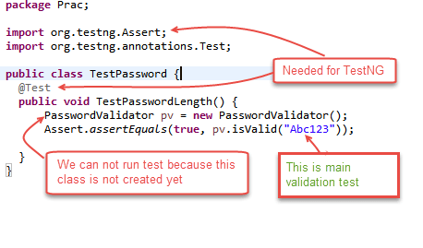
Examples of TDD: Here in this example, we will define a class password. For this class, we will try to satisfy following conditions. A condition for Password acceptance: The password should be between 5 to 10 characters. First, we write the code that fulfills all the above requirements.

Slide 81
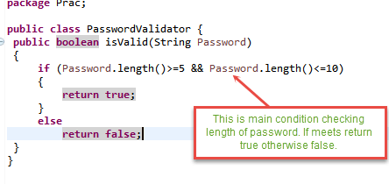
Scenario 1: To run the test, we create class PasswordValidator (); We will run above class TestPassword ();

Slide 82
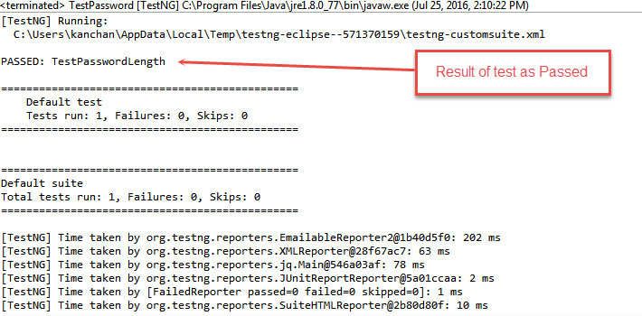
Output is PASSED as shown below

Slide 83
Advantages of TDD
Early bug notification
Better Designed, cleaner and more extensible code
Confidence to Refactor
Good for teamwork
Good for Developers

Slide 84
Summary
Test-driven development is a process of modifying the code in order to pass a test designed previously.
It more emphasis on production code rather than test case design.
In Software Engineering, It is sometimes known as "Test First Development."
TDD includes refactoring a code i.e. changing/adding some amount of code to the existing code without affecting the behavior of the code.
TDD when used, the code becomes clearer and simple to understand.

Slide 85
Questions
Distinguish Test Driven Development (TDD) Vs. Agile Model Driven Development (AMDD)
Explain any two scenarios of TDD with an Example
Distinguish TDD Vs. Traditional Testing
List out the advantages of TDD

Slide 86
19CS2211 - Software Engineering
White-Box Testing,
Validation Testing, System Testing
Session 22

Slide 87
White-box Testing
Called glass-box testing
Used in control structure
guarantee that all independent paths within a module have been exercised at least once
exercise all logical decisions on their true and false sides
execute all loops at their boundaries and within their operational bounds
exercise internal data structures to ensure their validity

Slide 88
White-box Testing
Basis path testing
Flow Graph Notation
Independent program paths
Deriving Basis sets and test cases
Graph Matrices

Slide 89
Basis Path Testing
White-box testing technique proposed by Tom McCabe
Enables the test case designer to derive a logical complexity measure of a procedural design.
Uses this measure as a guide for defining a basis set of execution paths
Test cases derived to exercise the basis set are guaranteed to execute every statement in the program at least one time during testing

Slide 90
Flow Graph Notation
A circle in a graph represents a node, which stands for a sequence of one or more procedural statements
A node containing a simple conditional expression is referred to as a predicate node
Each compound condition in a conditional expression containing one or more Boolean operators (e.g., and, or) is represented by a separate predicate node
A predicate node has two edges leading out from it (True and False)
An edge, or a link, is a an arrow representing flow of control in a specific direction
An edge must start and terminate at a node
An edge does not intersect or cross over another edge
Areas bounded by a set of edges and nodes are called regions
When counting regions, include the area outside the graph as a region, too

Slide 91
Flow Graph Example
FLOW CHART
FLOW GRAPH
0
0
R4
1
1
2
2
3
R3
3
6
4
6
4
R2
7
8
5
R1
7
8
5
9
9
11
10
11
10
Notes:
0-1-11
0-1—2-3-6-7-9-10-1-11
0-1-2-3-6-8-9-10-1-11
0-1-2-3-4-5-10-1-11

Slide 92
Independent Program Paths
Defined as a path through the program from the start node until the end node that introduces at least one new set of processing statements or a new condition (i.e., new nodes)
Must move along at least one edge that has not been traversed before by a previous path
Basis set for flow graph on previous slide
Path 1: 0-1-11
Path 2: 0-1-2-3-4-5-10-1-11
Path 3: 0-1-2-3-6-8-9-10-1-11
Path 4: 0-1-2-3-6-7-9-10-1-11
The number of paths in the basis set is determined by the cyclomatic complexity

Slide 93
Cyclomatic Complexity
Provides a quantitative measure of the logical complexity of a program
Defines the number of independent paths in the basis set
Provides an upper bound for the number of tests that must be conducted to ensure all statements have been executed at least once
Can be computed three ways
The number of regions
V(G) = E – N + 2, where E is the number of edges and N is the number of nodes in graph G
V(G) = P + 1, where P is the number of predicate nodes in the flow graph G
Results in the following equations for the example flow graph
Number of regions = 4
V(G) = 14 edges – 12 nodes + 2 = 4
V(G) = 3 predicate nodes + 1 = 4

Slide 94
Deriving the Basis Set and Test Cases
Using the design or code as a foundation, draw a corresponding flow graph
Determine the cyclomatic complexity of the resultant flow graph
Determine a basis set of linearly independent paths
Prepare test cases that will force execution of each path in the basis set

Slide 95
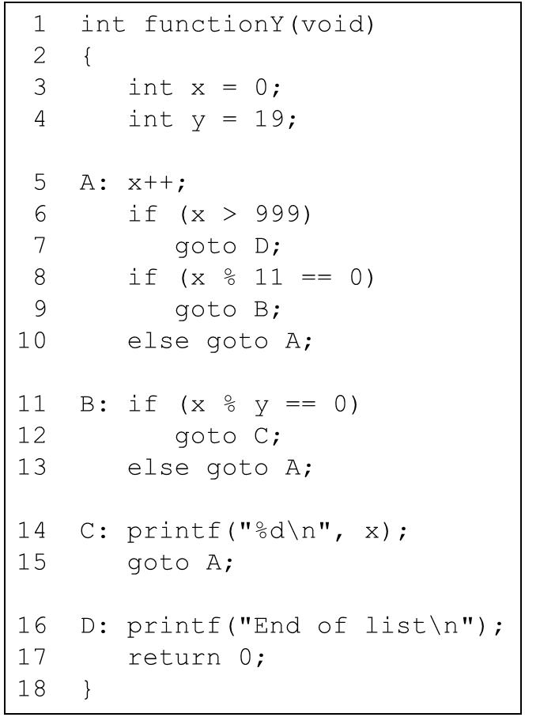

Slide 96
A Second Flow Graph Example
3
1 int functionY(void)
2 {
3 int x = 0;
4 int y = 19;
5 A: x++;
6 if (x > 999)
7 goto D;
8 if (x % 11 == 0)
9 goto B;
10 else goto A;
11 B: if (x % y == 0)
12 goto C;
13 else goto A;
14 C: printf("%d\n", x);
15 goto A;
16 D: printf("End of list\n");
17 return 0;
18 }
4
5
6
8
7
10
9
16
11
17
13
12
14
15

Slide 97
A Sample Function to Diagram and Analyze
1 int functionZ(int y)
2 {
3 int x = 0;
4 while (x <= (y * y))
5 {
6 if ((x % 11 == 0) &&
7 (x % y == 0))
8 {
9 printf(“%d”, x);
10 x++;
11 } // End if
12 else if ((x % 7 == 0) ||
13 (x % y == 1))
14 {
15 printf(“%d”, y);
16 x = x + 2;
} // End else
18 printf(“\n”);
19 } // End while
20 printf("End of list\n");
21 return 0;
22 } // End functionZ

Slide 98
A Sample Function to Diagram and Analyze
1 int functionZ(int y)
2 {
3 int x = 0;
4 while (x <= (y * y))
5 {
6 if ((x % 11 == 0) &&
7 (x % y == 0))
8 {
9 printf(“%d”, x);
10 x++;
11 } // End if
12 else if ((x % 7 == 0) ||
13 (x % y == 1))
14 {
15 printf(“%d”, y);
16 x = x + 2;
} // End else
18 printf(“\n”);
19 } // End while
20 printf("End of list\n");
21 return 0;
22 } // End functionZ
3
4
6
7
9
12
13
10
15
16
18
20
21

Slide 99
Graph Matrices
A graph matrix is a square matrix whose size (i.e., number of rows and columns) is equal to the number of nodes on a flow graph.
Each row and column corresponds to an identified node, and matrix entries correspond to connections (an edge) between nodes.
By adding a link weight to each matrix entry, the graph matrix can become a powerful tool for evaluating program control structure during testing

Slide 100
Graph Matrices
Connected to node
1
Node
1
2
3
4
5
a
3
1
 |  | a
 | d |  | b
 | c |  |  | f
 | g | e
e
2
b
5
4
3
d
f
4
c
g
5
2

Slide 101
Validation Testing
It begins at the culmination of integration testing
When individual components have been exercised, the software is completely assembled as a package, and interfacing errors have been uncovered and corrected.
At the validation or system level, the distinction between conventional software, object-oriented software, and WebApps disappears.
Testing focuses on user-visible actions and user-recognizable output from the system.

Slide 102
Validation Criteria:
After each validation test case has been conducted, one of two possible conditions exists:
The function or performance characteristic conforms to specification and is accepted or
a deviation from specification is uncovered and a deficiency list is created.
Note:
Deviations or errors discovered at this stage in a project can rarely be corrected prior to scheduled delivery.

Slide 103
Configuration Review:
To ensure that all elements of the software configuration have been properly developed, are cataloged, and have the necessary detail to bolster the support activities.

Slide 104
Alpha and Beta Testing
The alpha test:
Conducted at the developer’s site
Developer should present
Used in a natural setting with the developer “looking over the shoulder” of the users and recording errors and usage problems.
The beta test:
Conducted at one or more end-user sites.
Developer generally is not present.
Therefore, the beta test is a “live” application of the software in an environment that cannot be controlled by the developer.

Slide 105
A variation on beta testing, called customer acceptance testing:
Performed when software is delivered to a customer under contract.
The customer performs a series of specific tests in an attempt to uncover errors before accepting the software from the developer.

Slide 106
System Testing
Series of different tests whose primary purpose is to fully exercise the computer-based system.
Purpose - to verify that system elements have been properly integrated and perform allocated functions.

Slide 107
Recovery Testing:
It is a system test
It forces the software to fail in a variety of ways and verifies that recovery is properly performed.
If recovery is automatic (performed by the system itself), re-initialization, check pointing mechanisms, data recovery, and restart are evaluated for correctness.
Security Testing:
Protect the system from improper penetration.

Slide 108
Stress Testing:
Executes a system – with resources in abnormal quantity, frequency, or volume.
A variation of stress testing is a technique called sensitivity testing.
Sensitivity testing - to uncover data combinations within valid input classes that may cause instability or improper processing.

Slide 109
Performance Testing:
To test the run-time performance of software within the context of an integrated system.
Performance testing occurs throughout all steps in the testing process. Performance tests are often coupled with stress testing
It require both hardware and software instrumentation.

Slide 110
Deployment Testing:
Called configuration testing
Exercises the software in each environment in which it is to operate
Examines all installation procedures and specialized installation software (e.g., “installers”) that will be used by customers
All documentation that will be used to introduce the software to end users

Slide 111
Revision Questions
Define System Testing.
2. Outline the types of System testing.
Explain behavioral testing that make use of graphs.
Distinguish White Box and Black Box Testing.
Distinguish Validation Testing and Black Box Testing.
Distinguish Performance Testing and Deployment Testing.

Slide 112
Thank You

Slide 113
19CS2211 - Software Engineering
Test Driven Development
Session 23

Slide 114
Outline
Agenda:
Test Driven Development (TDD)
TDD – Mantra
TDD Versus Traditional Testing
Agile Model Driven Development (AMDD)
Revision Questions

Slide 115
Old School Approach
Design
Code
Test

Slide 116
New School Approach
Design
Test
Code

Slide 117
What is TDD?
TDD is a technique for building software that guides software development by writing tests
TDD is NOT primarily about testing or development (i.e., coding)
It is rather about design – where design is evolved through refactoring
Developer write unit tests (NOT testers) and then code

Slide 118
Performing TDD - Mantra
Failing Test(s)
RED
RE-FACTOR
GREEN
Passing Test(s))

Slide 119
Step 1: Write test that fails
Red: Write a little test that doesn’t work, perhaps doesn’t even compile at first
Fail

Slide 120
Step 2: Get code working to pass test
Green: Make the test work quickly, committing whatever necessary in the process
Pass

Slide 121
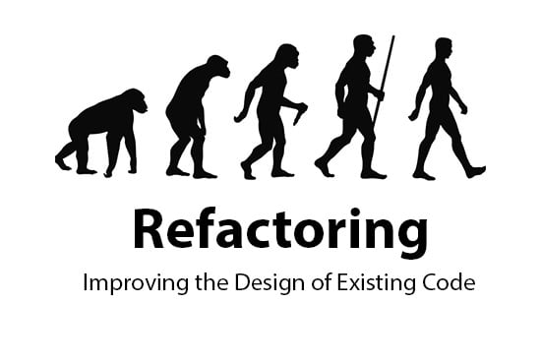
Step 3: Clean-up and Refactoring
Refactor: Eliminate all the duplication and smells created in just getting the test to work

Slide 122



Always leaves the code cleaner than you found it!
Always Remember Clean Code
Always Remember Clean Green

Slide 123
Clarification about TDD
TDD is neither about "Testing" nor about "Development".
• TDD does not mean "write some of the tests, then build a system that passes the tests”
• TDD does not mean "do lots of Testing."

Slide 124
TDD Versus Traditional Testing
TDD – Specification Technique & Ensures thoroughly source code is tested
Traditional Testing(TT) – Uncover error – solve it
TDD – Ensures meet requirement – it builds confidents about system
TDD – focus on production code – verifies the testing work properly or not
TT – focus on test case design
TDD – Every single line of code is tested
TT – Not all lines are tested
Notes:
e

Slide 125
TDD & TT
The combination of both TT & TDD leads to the importance of testing the system rather than perfection of the system.
• In Agile Modeling (AM), leads to the "test with a purpose".
Should know why are testing something and what level its need to be tested.

Slide 126
Levels of TDD
Levels of TDD
Acceptance TDD
Developer TDD
It Tests – Requirement Specifications
Write production code – to fulfill the acceptance test
It is called as Behavioral Driven Development (BDD)
Unit Test – focus on functionality of the system
Production Test
It is simply called TDD

Slide 127


Goal of ATDD & TDD
Without TDD
With TDD
Main goal of ATDD and TDD:
To specify detailed, executable requirements for solution on a just in time (JIT) basis.
JIT means taking only those requirements in consideration that are needed in the system. So increase efficiency.

Slide 128
ATDD & DTDD

Slide 129
Agile Model Driven Development (AMDD)
AMDD addresses the Agile scaling issues that TDD does not.

Slide 130
Iteration 0: Envisioning
Envisioning
Initial Requirements Envisioning
Initial Architectural Envisioning
Main goal is to explore
1. Usage Model
2. Initial Domain Model
3. User Interface Model
Main goal is to explore
Set technical directions for projects
Technology diagrams
User Interface Flow
Domain Models
Change Cases

Slide 131
Iteration Modeling
• Team must plan the work that will be done for each iteration
• Agile process is used for each iteration - new work item will be added with priority in each iteration
• Higher prioritized work – taken into consideration
• Work items added – reprioritized / removed from stack
• Team discusses – to implement each requirement. Modeling is used for this purpose
• Modeling analysis and design is done for each requirement which is going to implement for that iteration

Slide 132
Model storming (Just in time modeling)
• Modeling session involves a team of 2/3 members
• One team member will ask another to model with them. Session will take 5 to 10 minutes.
• Explore issues until – find the main cause of the problem.
• Just in time, if one team member identifies the issue - wants to resolve – then take quick help of other team members.
• Other group members then explore the issue and then everyone continues on as before.
• It is also called as stand-up modeling or customer QA sessions.

Slide 133
Test Driven Development
It promotes confirmatory testing of application code and detailed specification.
Both acceptance test (detailed requirements) and developer tests (unit test) are inputs for TDD.
TDD makes the code simpler and clear. It allows the developer to maintain less documentation.

Slide 134
Revision Questions
Define TDD.
Outline the steps need to performed for TDD Test.
Distinguish TDD and Traditional Testing
Explain in detail about Acceptance Testing and Developer Testing.
Distinguish Scaling TDD and AMDD.
Explain the Life cycle of AMDD.

Slide 135
Thank You

Slide 136
Session – 24
CMMI and Six Sigma

Slide 137
Capability Maturity Model Integration
Capability Maturity Model Integration (CMMI), a comprehensive process meta-model that is predicated on a set of system and software engineering capabilities that should be present as organizations reach different levels of process capability and maturity.
The CMMI represents a process meta-model in two different ways: (1) as a “continuous” model and (2) as a “staged” model.

Slide 138
Levels of CMMI
Each process area (e.g., project planning or requirements management) is formally assessed against specific goals and practices and is rated according to the following capability levels:
Level 0: Incomplete
Level 1: Performed
Level 2: Managed
Level 3: Defined
Level 4: Quantitatively managed
Level 5: Optimized
The CMMI defines each process area in terms of “specific goals” and the “specific practices” required to achieve these goals. Specific goals establish the characteristics that must exist if the activities implied by a process area are to be effective. Specific practices refine a goal into a set of process-related activities.

Slide 139
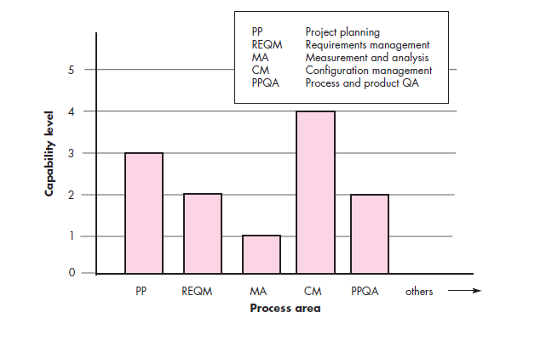
CMMI Process Area Capability Profile

Slide 140
Specific Goals of CMMI
associated specific practices (SP) defined for project planning are:
SG 1 Establish Estimates
SP 1.1-1 Estimate the Scope of the Project
SP 1.2-1 Establish Estimates of Work Product and Task Attributes
SP 1.3-1 Define Project Life Cycle
SP 1.4-1 Determine Estimates of Effort and Cost
SG 2 Develop a Project Plan
SP 2.1-1 Establish the Budget and Schedule
SP 2.2-1 Identify Project Risks
SP 2.3-1 Plan for Data Management
SP 2.4-1 Plan for Project Resources
SP 2.5-1 Plan for Needed Knowledge and Skills
SP 2.6-1 Plan Stakeholder Involvement
SP 2.7-1 Establish the Project Plan
SG 3 Obtain Commitment to the Plan
SP 3.1-1 Review Plans That Affect the Project
SP 3.2-1 Reconcile Work and Resource Levels
SP 3.3-1 Obtain Plan Commitment

Slide 141
CMMI also defines a set of five generic goals
The generic goals (GG) and practices (GP) for the project planning process area are:
GG 1 Achieve Specific Goals
GP 1.1 Perform Base Practices
GG 2 Institutionalize a Managed Process
GP 2.1 Establish an Organizational Policy
GP 2.2 Plan the Process
GP 2.3 Provide Resources
GP 2.4 Assign Responsibility
GP 2.5 Train People
GP 2.6 Manage Configurations
GP 2.7 Identify and Involve Relevant Stakeholders
GP 2.8 Monitor and Control the Process
GP 2.9 Objectively Evaluate Adherence
GP 2.10 Review Status with Higher-Level Management

Slide 142
GG 3 Institutionalize a Defined Process
GP 3.1 Establish a Defined Process
GP 3.2 Collect Improvement Information
GG 4 Institutionalize a Quantitatively Managed Process
GP 4.1 Establish Quantitative Objectives for the Process
GP 4.2 Stabilize Subprocess Performance
GG 5 Institutionalize an Optimizing Process
GP 5.1 Ensure Continuous Process Improvement
GP 5.2 Correct Root Causes of Problems

Slide 143
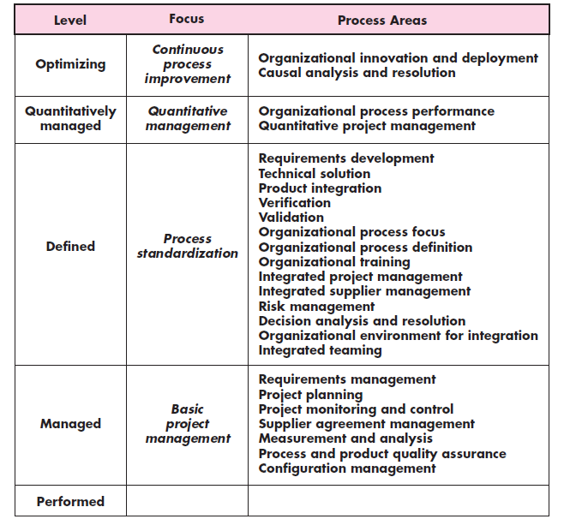
Process area required to achieve a maturity Level

Slide 144
Six Sigma for Software Engineering
Six Sigma is the most widely used strategy for statistical quality assurance in industry today.
the Six Sigma strategy “is a rigorous and disciplined methodology that uses data and statistical analysis to measure and improve a company’s operational performance by identifying and eliminating defects’ in manufacturing and service-related processes”.
The term Six Sigma is derived from six standard deviations—3.4 instances (defects) per million occurrences—implying an extremely high quality standard

Slide 145
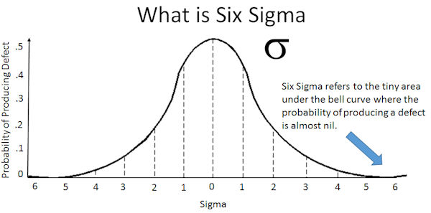

Slide 146
The Six Sigma methodology defines three core steps:
Define customer requirements and deliverables and project goals via well defined methods of customer communication.
Measure the existing process and its output to determine current quality performance (collect defect metrics).
Analyze defect metrics and determine the vital few causes.
If an existing software process is in place, but improvement is required, Six Sigma suggests two additional steps:
Improve the process by eliminating the root causes of defects.
Control the process to ensure that future work does not reintroduce the causes of defects.
These core and additional steps are sometimes referred to as the DMAIC (define, measure, analyze, improve, and control) method.

Slide 147
If an organization is developing a software process (rather than improving an existing process), the core steps are augmented as follows:
Design the process to (1) avoid the root causes of defects and (2) to meet customer requirements.
Verify that the process model will, in fact, avoid defects and meet customer requirements.
This variation is sometimes called the DMADV (define, measure, analyze, design, and verify) method.

Slide 148
Questions
Distinguish CMMI and Six Sigma Method.
Explain various levels of CMMI in detail.
Explain the core and additional steps of Six sigma methodology.
List out specific goals and associated specific practices defined in CMMI.
List out generic goals and practices of CMMI.

Slide 149
19CS2211 - Software Engineering
JUnit
Session 25

Slide 150
Outline
Agenda:
Junit Architecture
Test case
Assert methods

Slide 151
History
Kent Beck developed the first xUnit automated test tool for Smalltalk in mid-90’s.
Beck and Gamma (of design patterns Gang of Four) developed JUnit on a flight from Zurich to Washington, D.C.
Junit has become the standard tool for Test-Driven Development in Java (see Junit.org)
Junit test generators now part of many Java IDEs – Eclipse, BlueJ, Jbuilder, DrJava
Xunit tools have since been developed for many other languages – Perl, C++, Python, Visual Basic, C#, …

Slide 152
Why create a test suite?
Obviously you have to test your code—right?
You can do ad hoc testing (running whatever tests occur to you at the moment), or
You can build a test suite (a thorough set of tests that can be run at any time)
Disadvantages of a test suite
It’s a lot of extra programming
True, but use of a good test framework can help quite a bit
You don’t have time to do all that extra work
False! Experiments repeatedly show that test suites reduce debugging time more than the amount spent building the test suite
Advantages of a test suite
Reduces total number of bugs in delivered code
Makes code much more maintainable and re-factorable

Slide 153
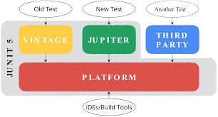
Junit – Basic Structure

Slide 154
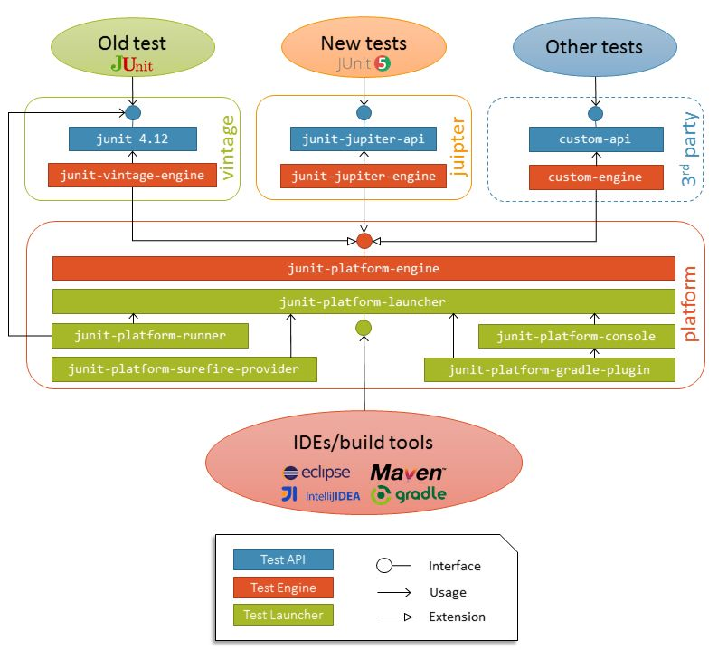
Junit - Detailed Architectural Overview

Slide 155
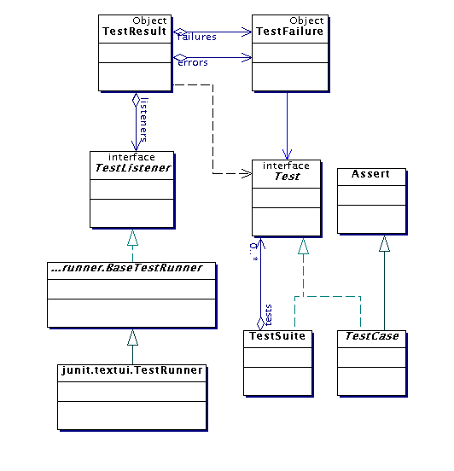
Architectural overview
JUnit test framework is a package of classes that lets you write tests for each method, then easily run those tests
TestRunner runs tests and reports TestResults
You test your class by extending abstract class TestCase
To write test cases, you need to know and understand the Assert class

Slide 156
Writing a TestCase
To start using JUnit, create a subclass of TestCase, to which you add test methods
Here’s a skeletal test class:
import junit.framework.TestCase;
public class TestBowl extends TestCase {
} //Test my class Bowl
Name of class is important – should be of the form TestMyClass or MyClassTest
This naming convention lets TestRunner automatically find your test classes

Slide 157
Writing methods in TestCase
Pattern follows programming by contract paradigm:
Set up preconditions
Exercise functionality being tested
Check postconditions
Example:
public void testEmptyList() {
Bowl emptyBowl = new Bowl();
assertEquals(“Size of an empty list should be zero.”,
0, emptyList.size());
assertTrue(“An empty bowl should report empty.”, emptyBowl.isEmpty());
}
Things to notice:
Specific method signature – public void testWhatever()
Allows them to be found and collected automatically by JUnit
Coding follows pattern
Notice the assert-type calls…

Slide 158
Assert methods
Each assert method has parameters like these: message, expected-value, actual-value
Assert methods dealing with floating point numbers get an additional argument, a tolerance
Each assert method has an equivalent version that does not take a message – however, this use is not recommended because:
messages helps documents the tests
messages provide additional information when reading failure logs

Slide 159
Assert methods Cont…
assertTrue(String message, Boolean test)
assertFalse(String message, Boolean test)
assertNull(String message, Object object)
assertNotNull(String message, Object object)
assertEquals(String message, Object expected, Object actual) (uses equals method)
assertSame(String message, Object expected, Object actual) (uses == operator)
assertNotSame(String message, Object expected, Object actual)

Slide 160
More stuff in test classes
Suppose you want to test a class Counter
public class CounterTest extends junit.framework.TestCase {
This is the unit test for the Counter class
public CounterTest() { } //Default constructor
protected void setUp()
Test fixture creates and initializes instance variables, etc.
protected void tearDown()
Releases any system resources used by the test fixture
public void testIncrement(), public void testDecrement()
These methods contain tests for the Counter methods increment(), decrement(), etc.
Note capitalization convention

Slide 161
JUnit tests for Counter
public class CounterTest extends junit.framework.TestCase { Counter counter1; public CounterTest() { } // default constructor
protected void setUp() { // creates a (simple) test fixture counter1 = new Counter(); }
public void testIncrement() { assertTrue(counter1.increment() == 1); assertTrue(counter1.increment() == 2); }
public void testDecrement() { assertTrue(counter1.decrement() == -1); } }
Note that each test begins with a brand new counter
This means you don’t have to worry about the order in which the tests are run

Slide 162
TestSuites
TestSuites collect a selection of tests to run them as a unit
Collections automatically use TestSuites, however to specify the order in which tests are run, write your own:
public static Test suite() {
suite.addTest(new TestBowl(“testBowl”));
suite.addTest(new TestBowl(“testAdding”));
return suite;
}
Should seldom have to write your own TestSuites as each method in your TestCase should be independent of all others
Can create TestSuites that test a whole package:
public static Test suite() {
TestSuite suite = new TestSuite();
suite.addTestSuite(TestBowl.class);
suite.addTestSuite(TestFruit.class);
return suite; }

Slide 163
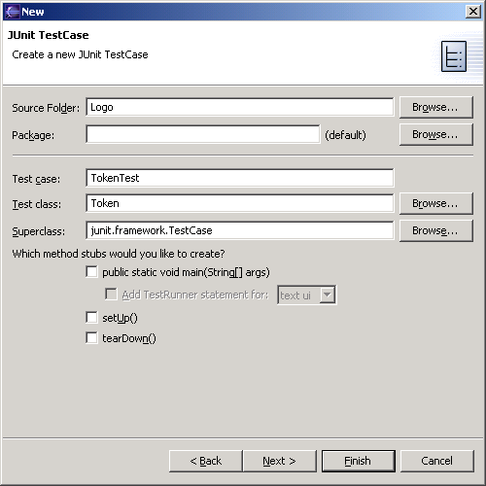
JUnit in Eclipse
To create a test class, select File→ New→ Other... → Java, JUnit, TestCase and enter the name of the class you will test
Fill this in
This will be filled in automatically

Slide 164
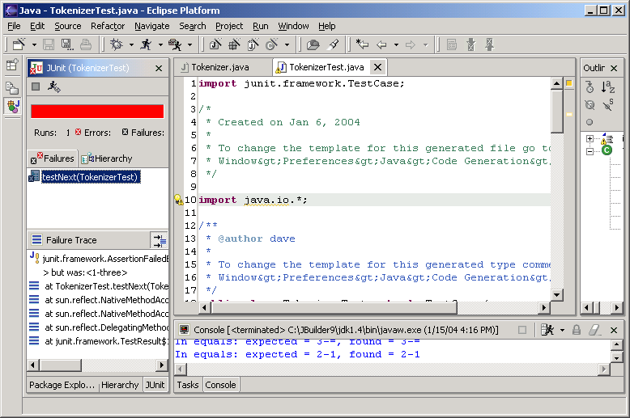
Results
Your results are here

Slide 165
Unit testing for other languages
Unit testing tools differentiate between:
Errors (unanticipated problems caught by exceptions)
Failures (anticipated problems checked with assertions)
Basic unit of testing:
CPPUNIT_ASSERT(Bool) examines an expression
CPPUnit has variety of test classes (e.g. TestFixture)
Inherit from them and overload methods

Slide 166
More Information
http://www.junit.org
Download of JUnit
Lots of information on using JUnit
http://sourceforge.net/projects/cppunit
C++ port of Junit
http://www.thecoadletter.com
Information on Test-Driven Development

Slide 167
Thank You

Slide 168
19CS2211 - Software Engineering
CMMI and Six Sigma
Session 26

Slide 169
Outline
Agenda:
Definition – CMMI
Levels of CMMI
Six Sigma
Questions

Slide 170
CMMI
Definition
The Capability Maturity Model Integration (CMMI) is a process and behavioral model that helps organizations streamline process improvement and encourage productive, efficient behaviors that decreases risks in software, product and service development.

Slide 171
Levels of CMMI
Each process area (e.g., project planning or requirements management) is formally assessed against specific goals and practices and is rated according to the following capability levels:
Level 0: Incomplete
Processes are viewed as unpredictable and reactive
an unpredictable environment that increases risk and inefficiency.

Slide 172
Level 1: Performed
There’s information on how to establish performance goals and then track those goals to make sure they’re achieved at all levels of business maturity.
Level 2: Managed
Projects - planned, performed, measured and controlled – at this level.
But there are still a lot of issues to address.
Level 3: Defined
organizations are more proactive than reactive
A set of “organization-wide standards” to “provide guidance across projects, programs and portfolios.”

Slide 173
Level 4: Quantitatively managed
measured and controlled
quantitative data to determine predictable processes that align with stakeholder needs
Level 5: Optimized
organization’s processes are stable and flexible
organization will be in constant state of improving and responding to changes or other opportunities
Organization is stable, which allows for more “agility and innovation,” in a predictable environment

Slide 174
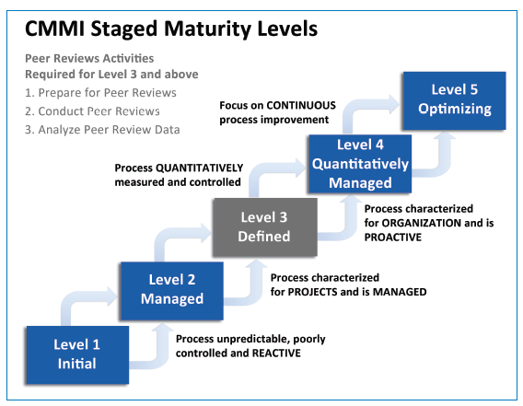

Slide 175
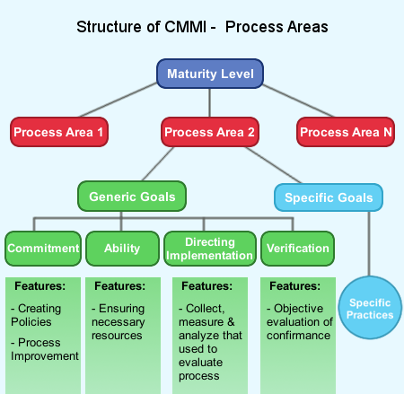

Slide 176
CMMI defines each process area in terms of specific goals
Specific practices required to achieve these goals
Specific practices refine a goal into a set of process-related activities

Slide 177
CMMI Process Area Capability Profile

Slide 178
Specific Goals of CMMI
Associated specific practices (SP) defined for project planning are:
SG 1 Establish Estimates
SP 1.1-1 Estimate the Scope of the Project
SP 1.2-1 Establish Estimates of Work Product and Task Attributes
SP 1.3-1 Define Project Life Cycle
SP 1.4-1 Determine Estimates of Effort and Cost
SG 2 Develop a Project Plan
SP 2.1-1 Establish the Budget and Schedule
SP 2.2-1 Identify Project Risks
SP 2.3-1 Plan for Data Management
SP 2.4-1 Plan for Project Resources
SP 2.5-1 Plan for Needed Knowledge and Skills
SP 2.6-1 Plan Stakeholder Involvement
SP 2.7-1 Establish the Project Plan
SG 3 Obtain Commitment to the Plan
SP 3.1-1 Review Plans That Affect the Project
SP 3.2-1 Reconcile Work and Resource Levels
SP 3.3-1 Obtain Plan Commitment

Slide 179
CMMI also defines a set of five generic goals
The generic goals (GG) and practices (GP) for the project planning process area are:
GG 1 Achieve Specific Goals
GP 1.1 Perform Base Practices
GG 2 Institutionalize a Managed Process
GP 2.1 Establish an Organizational Policy
GP 2.2 Plan the Process
GP 2.3 Provide Resources
GP 2.4 Assign Responsibility
GP 2.5 Train People
GP 2.6 Manage Configurations
GP 2.7 Identify and Involve Relevant Stakeholders
GP 2.8 Monitor and Control the Process
GP 2.9 Objectively Evaluate Adherence
GP 2.10 Review Status with Higher-Level Management

Slide 180
GG 3 Institutionalize a Defined Process
GP 3.1 Establish a Defined Process
GP 3.2 Collect Improvement Information
GG 4 Institutionalize a Quantitatively Managed Process
GP 4.1 Establish Quantitative Objectives for the Process
GP 4.2 Stabilize Subprocess Performance
GG 5 Institutionalize an Optimizing Process
GP 5.1 Ensure Continuous Process Improvement
GP 5.2 Correct Root Causes of Problems

Slide 181
Process area required to achieve a maturity Level

Slide 182
Six Sigma for Software Engineering
Six Sigma – suitable for statistical quality assurance in industry today
It uses data and statistical analysis to measure and improve a company’s operational performance by identifying and eliminating defects’ in manufacturing and service-related processes
The term Six Sigma is derived from six standard deviations—3.4 instances (defects) per million occurrences—implying an extremely high quality standard

Slide 184
The Six Sigma methodology defines three core steps:
Define
customer requirements
deliverables and
project goals
via well defined methods of customer communication
Measure the existing process and its output to determine current quality performance (collect defect metrics).
Analyze defect metrics and determine the vital few causes.

Slide 185
If an existing software process is in place, but improvement is required, Six Sigma suggests two additional steps:
Improve the process by eliminating the root causes of defects
Control the process to ensure that future work does not reintroduce the causes of defects
These core and additional steps are sometimes referred to as the DMAIC (define, measure, analyze, improve, and control) method

Slide 186
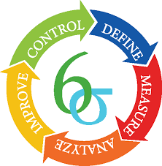

Slide 187
If an organization is developing a software process (rather than improving an existing process), the core steps are augmented as follows:
Design the process
to avoid the root causes of defects
to meet customer requirements
Verify that the process model to avoid defects and meet customer requirements.
This variation is sometimes called the DMADV (define, measure, analyze, design, and verify) method.

Slide 188
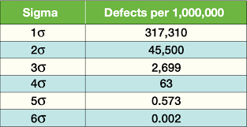

Slide 189
Questions
Distinguish CMMI and Six Sigma Method.
Explain various levels of CMMI in detail.
Explain the core and additional steps of Six sigma methodology.
List out specific goals and associated specific practices defined in CMMI.
List out generic goals and practices of CMMI.

Slide 190
Thank You

